Slide 1
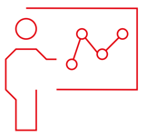
Introduction to RNA-Seq: Mapping & Aligning
Wandrille Duchemin

Slide 2
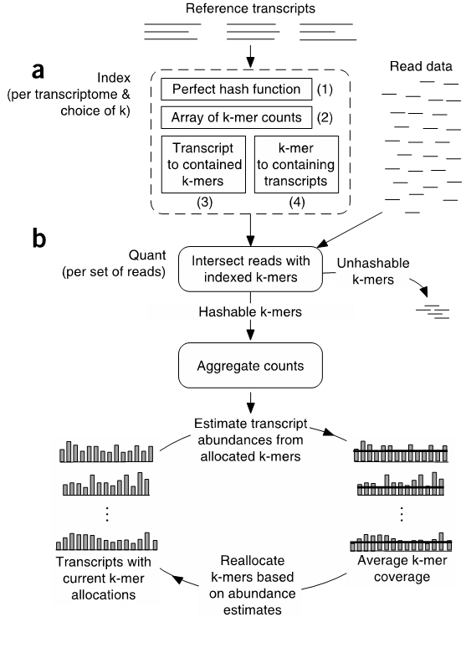
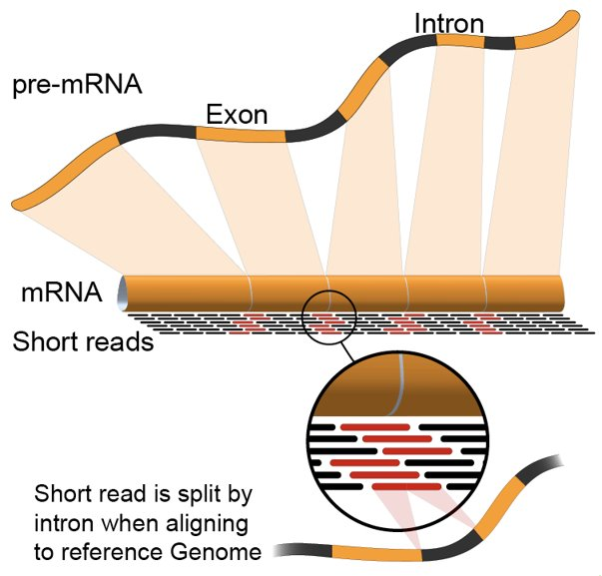

Alignment vs. pseudoalignment
Image credit : wikipedia user Rgocs
Sailfish (Patro et al. 2014),
See also Kallisto (Bray et al. 2016)

Slide 3
Alignment vs. pseudoalignment
Resource intensive!
Image credit : wikipedia user Rgocs
Sailfish (Patro et al. 2014),
See also Kallisto (Bray et al. 2016)

Slide 4
Alignment vs. pseudoalignment
alignment
pseudo-alignment
Mapped reads
Transcript-level
counts

Slide 5
Alignment vs. pseudoalignment
alignment
pseudo-alignment
Mapped reads
Transcript
quantification
Transcript-level
counts
Transcript-level
DE, ...
summarization
Transcript
assembly
Gene
quantification
Gene-level counts
Gene-level
DE, ...
Variant
calling
...

Slide 6
Alignment vs. pseudoalignment
alignment
bowtie2
STAR
tophat2
pseudo-alignment
salmon
kallisto
Mapped reads
Transcript
quantification
Transcript-level
counts
Transcript-level
DE, ...
summarization
Transcript
assembly
Gene
quantification
Gene-level counts
Gene-level
DE, ...
Variant
calling
...

Slide 7
Alignment vs. pseudoalignment
alignment
bowtie2
STAR
tophat2
pseudo-alignment
salmon
kallisto
Mapped reads
Transcript
quantification
Transcript-level
counts
Transcript-level
DE, ...
RSEM
Cufflinks
salmon
tximport
summarization
Transcript
assembly
Gene
quantification
Gene-level counts
Gene-level
DE, ...
Variant
calling
STAR
featurecount
...

Slide 8
Alignment vs. pseudoalignment
alignment
bowtie2
STAR
tophat2
pseudo-alignment
salmon
kallisto
Mapped reads
Transcript
quantification
Transcript-level
counts
Transcript-level
DE, ...
RSEM
Cufflinks
salmon
tximport
summarization
stringtie
Transcript
assembly
Gene
quantification
Gene-level counts
Gene-level
DE, ...
Variant
calling
STAR
featurecount
GATK
...

Slide 9

Aligning & mapping sequencing reads
Whole genome re-sequencing
Prokaryote RNAseq
Transcriptome sequencing (RNA-seq)
Aligner
Aligner
BWA (Li and Durbin 2009)
Bowtie (Langemead et al. 2009)
Tophat (Trapenell et al. 2009, Kim et al. 2013)
STAR (Dobin et al. 2013)

Slide 10
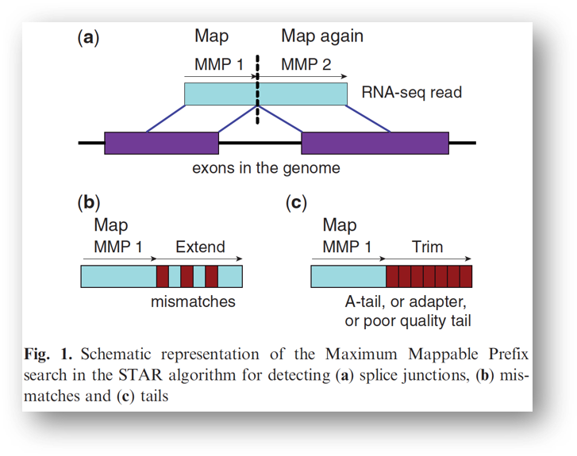
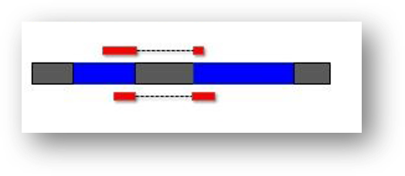
Alignment using STAR
Phase 1:
mapping using "Maximum Mappable Prefix"
Phase 2:
"stitching"
Dobin et al. 2013

Slide 11
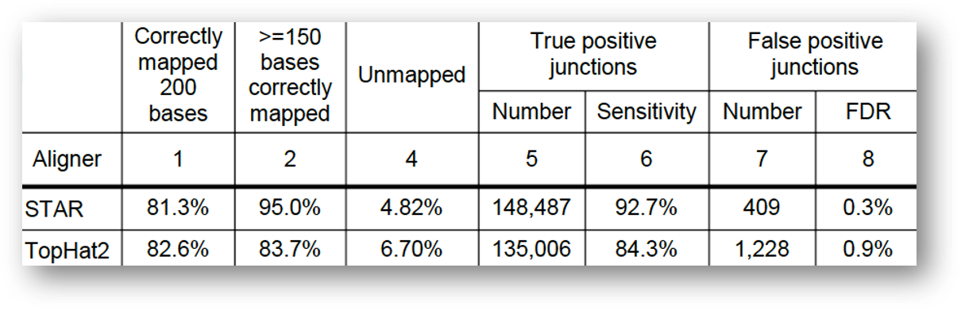
Benchmarking of RNAseq aligners
Dobin & Gingeras 2013
STAR : 20x faster
Tophat2 : 6x less memory (can be run on recent laptop)

Slide 12
Benchmarking of RNAseq aligners
Dobin & Gingeras 2013
STAR : 20x faster
Tophat2 : 6x less memory (can be run on recent laptop)

Slide 13
Reference index preparation
Different for each software!
Needs a suitable reference genome
sequence
annotation
https://www.ensembl.org/info/data/ftp/index.html
https://hgdownload.soe.ucsc.edu/downloads.html

Slide 14
Genome annotation files
Text file describing genomic features
Gene, CDS, exon, intron, …
Chromosome, start, end, strand, attributes, ...
Most common format: gtf / gff3
http://www.ensembl.org/info/website/upload/gff.html
MT RefSeq gene 2751 3707 . + . gene_id "ENSMUSG00000064341"; gene_version "1"...
MT RefSeq transcript 2751 3707 . + . gene_id "ENSMUSG00000064341"; gene_version "1";
MT RefSeq exon 2751 3707 . + . gene_id "ENSMUSG00000064341"; gene_version "1"; transcript_support_level "NA";
MT RefSeq CDS 2751 3704 . + 0 gene_id "ENSMUSG00000064341"; gene_version "1"; transcript_support_level "NA";
MT RefSeq start_codon 2751 2753 . + 0 gene_id "ENSMUSG00000064341"; gene_vers
MT RefSeq stop_codon 3705 3707 . + 0 gene_id "ENSMUSG00000064341"; gene_vers

Slide 15
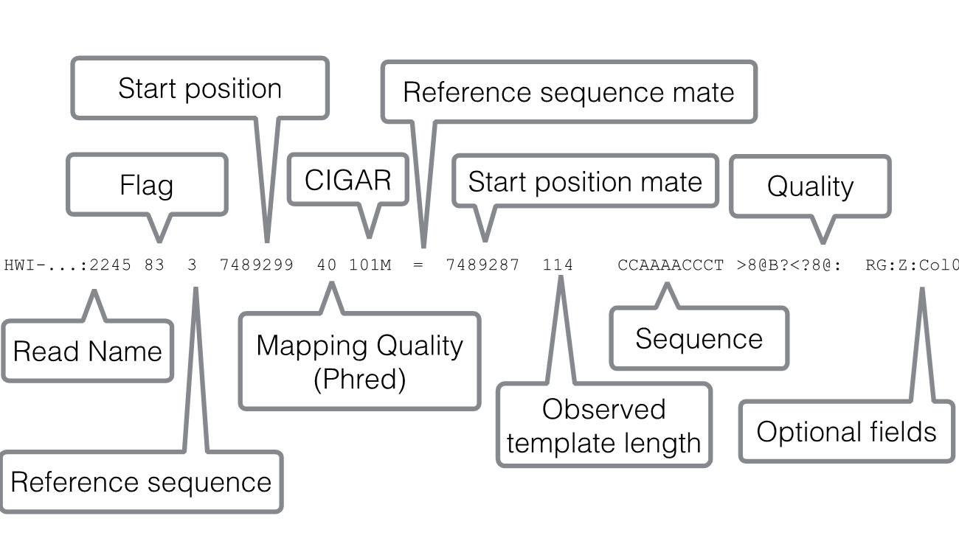
Most mapper produce SAM files
https://samtools.github.io/hts-specs/SAMv1.pdf
Each line contain mapping information about a single read

Slide 16
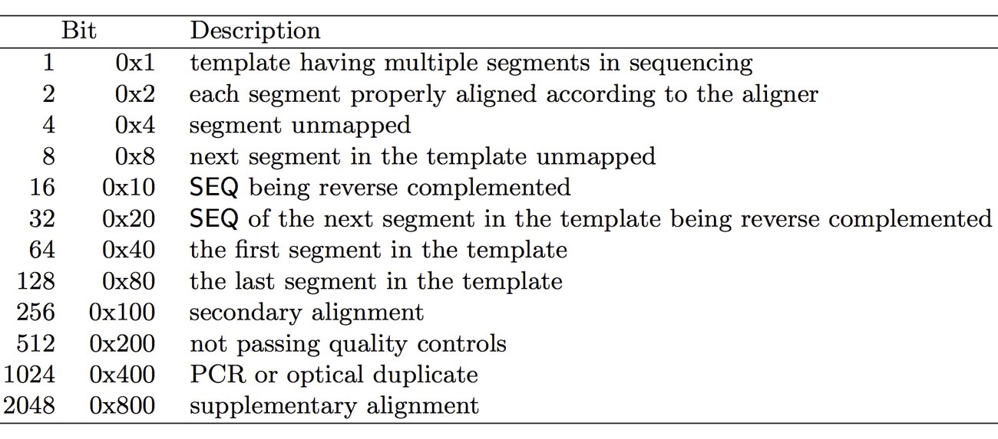
Most mapper produce SAM files
https://samtools.github.io/hts-specs/SAMv1.pdf
Example, flag 83 = 64+16+2+1 means it's first read (0x40) of pair-end reads (0x1) and it's mapped on minus strand (0x10) and both reads mapped (0x2).
https://broadinstitute.github.io/picard/explain-flags.html

Slide 17
Most mapper produce SAM files
https://samtools.github.io/hts-specs/SAMv1.pdf
Big files: ideally compress in BAM file
Can be sorted and indexed for easy access by post-processing software
multiQC can grab interesting information from a folder containing SAM/BAM files
(as well as the other files created by the mapping software)

Slide 18
After mapping: counting
Pseudoaligner: transcript-level expression quantification
Aligner: we need to subsequently estimate expression from mapped reads

Slide 19
Counting: fundamental problems
Overlapping genes
stranded sequencing
OR
discard reads / count both ?
Gene 1
Gene 2
Multi-mapping reads
discard reads?
count both?
Gene 1
Gene 2

Slide 20
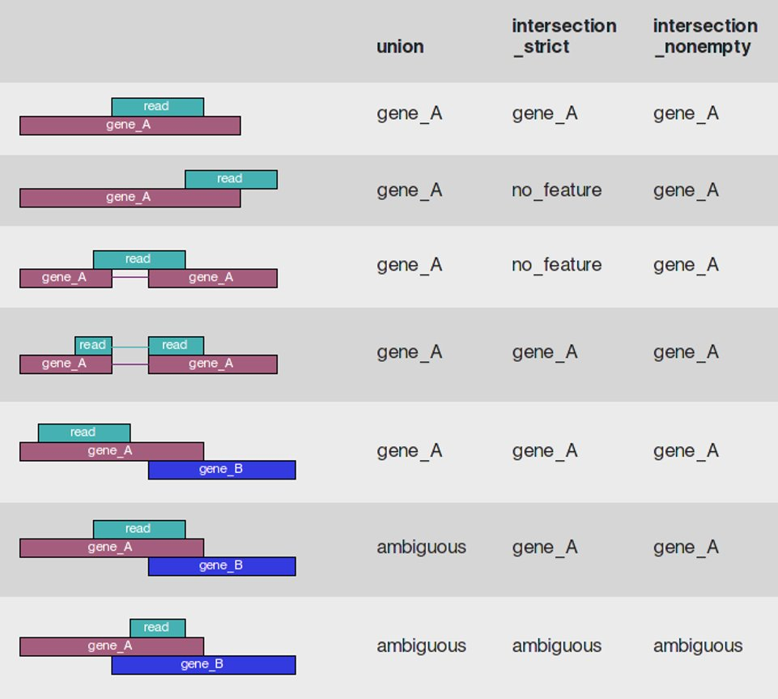
Counting: gene-level counters
HTSeq

Slide 21
Counting: gene-level counters
HTSeq
FeatureCount
+ options for
fractional counts

Slide 22
Counting: gene-level counters
HTSeq
FeatureCount
+ options for
fractional counts
STAR

Slide 23
Counting: transcript-level counter
Transcript A
Transcript B
RSEM, cufflink, salmon, stringtie, ...

Slide 24
Practical

Slide 25
Thank you

Slide 26
Counting: transcript-level counter
Transcript A
Transcript B
RSEM, cufflink, salmon, stringtie, ...

